Slide 1
Chapter - 5
Dynamic Programming

Slide 2
Dynamic Programming
Well known algorithm design techniques:.
  Divide-and-conquer algorithms
Another strategy for designing algorithms is dynamic programming.
  Used when problem breaks down into recurring small subproblems
Dynamic programming is typically applied to optimization problems. In such problem there can be many solutions. Each solution has a value, and we wish to find a solution with the optimal value.
Notes:
2️⃣ Dynamic Programming (DP)
🔹 Idea
👉 Used when subproblems overlap
👉 Store solutions to avoid recomputation
Important:
Subproblems are repeated again and again.
🔹 Example: Fibonacci
We know:
F(n)=F(n−1)+F(n−2)F(n) = F(n-1) + F(n-2)F(n)=F(n−1)+F(n−2) Let’s compute F(5)
Using Normal Recursion:
F(5)
├── F(4)
│ ├── F(3)
│ │ ├── F(2)
│ │ └── F(1)
│ └── F(2)
└── F(3)
├── F(2)
└── F(1)
⚠ Notice:
F(3) is calculated multiple times
F(2) is calculated multiple times
This is overlapping subproblems
🔹 Using Dynamic Programming
We store results in a table:
F(0)=0
F(1)=1
F(2)=1
F(3)=2
F(4)=3
F(5)=5
Each value computed only once ✅
Time reduces from O(2ⁿ) → O(n)

Slide 3
Divide-and-conquer
Divide-and-conquer method for algorithm design:
Divide: If the input size is too large to deal with in a straightforward manner, divide the problem into two or more disjoint subproblems
Conquer: conquer recursively to solve the subproblems
Combine: Take the solutions to the subproblems and “merge” these solutions into a solution for the original problem
Notes:
🟢 1️⃣ Divide and Conquer (D & C)
🔹 Idea
👉 Break problem into smaller independent subproblems
👉 Solve each recursively
👉 Combine their results
Important:
Subproblems do NOT overlap
🔹 Example: Merge Sort
Problem: Sort an array
Example:
[4, 2, 7, 1]
Divide:
[4,2] [7,1]
Divide again:
[4] [2] [7] [1]
Conquer:
Sort small parts
Combine:
[2,4] and [1,7]
Final: [1,2,4,7]
✔ Subproblems are independent
✔ No repeated work

Slide 4
DP Vs Divide-and-Conquer
Divide-&-conquer works best when all subproblems are independent.
    So, pick partition that makes algorithm most efficient & simply combine solutions to solve entire problem.
    Divide-&-conquer is best suited for the case when no “overlapping subproblems” are encountered.
Dynamic programming is needed when subproblems are dependent;
    we don’t know where to partition the problem
    In dynamic programming algorithms, we typically solve each sub problem only once and store their solutions in a table. But this is at the cost of space
    “Programming” refers to a tabular method

Slide 5
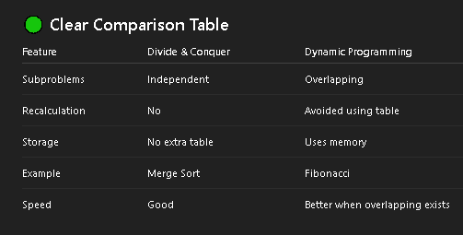

DP Vs Divide-and-Conquer

Slide 6
DP Vs Greedy Method
Both algorithms are used for obtaining optimal solution.
GM pics a optimal solution form the set of feasible solutions, where as DP does not create any feasible solution set.
DP considers all possible sequences, where as GM will not revise previously generated solutions
GM does not guarantee of getting optimum solution, where as DP will.
DP solves the sub-problems bottom up, where as GM solves the sub-problems from top down.
Notes:
🟢 Greedy Method
🔹 Definition
Greedy method is an algorithm design technique that makes the best choice at the current step without worrying about the future.
It always picks the locally optimal solution, hoping it leads to a global optimal solution.
🟢 Simple Meaning
Greedy means:
👉 "Take what looks best right now."
It does not reconsider previous decisions.
🟢 How Greedy Works
At every step:
Choose the best available option.
Add it to the solution.
Never change that choice.
🟢 Simple Example 1: Coin Change (Greedy Works)
Suppose coins: ₹1, ₹2, ₹5, ₹10
Make ₹18.
Greedy picks:
10 → remaining 8
5 → remaining 3
2 → remaining 1
1 → remaining 0
✔ Total coins used = 4
✔ This is optimal.
Here greedy works perfectly.
🟢 Simple Example 2: Where Greedy Fails
Coins: ₹1, ₹3, ₹4
Make ₹6
Greedy picks:
4 → remaining 2
1 → remaining 1
1 → remaining 0
Total = 3 coins
But better solution:
3 + 3 = 2 coins ✅
❌ Greedy failed here.
🟢 Characteristics of Greedy Method
✔ Makes local best choice
✔ Fast and simple
✔ Does not store subproblems
✔ Does not reconsider decisions
✔ May or may not give optimal solution
🟢 When Greedy Works?
Greedy works when problem has:
1️⃣ Greedy Choice Property
2️⃣ Optimal Substructure
🟢 Greedy vs Dynamic Programming
GreedyDynamic ProgrammingTakes immediate bestChecks all possibilitiesNo backtrackingBuilds tableFasterSlowerMay failAlways optimal
🟢 Applications of Greedy
✔ Fractional Knapsack
✔ Job Sequencing with Deadlines
✔ Huffman Coding
✔ Minimum Spanning Tree (Prim’s, Kruskal’s)
✔ Dijkstra’s Algorithm
🟢 Exam Ready Definition
Greedy method is an algorithm technique that builds a solution step-by-step by always choosing the locally optimal choice at each stage.

Slide 7
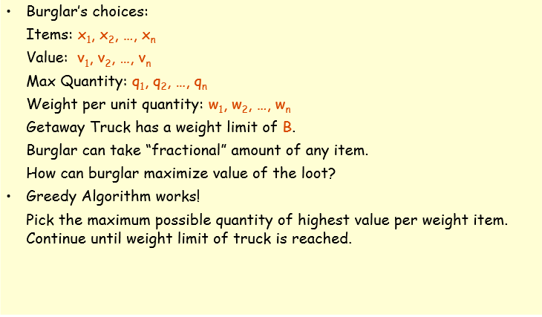
Fractional Knapsack Problem
Notes:
🟢 Fractional Knapsack Problem
🔹 Definition
In the Fractional Knapsack problem, items are divisible, meaning we can take whole item or fraction of item to maximize profit.
🔹 Given
n items
Each item has:
Weight (wi)
Value (vi)
Knapsack capacity = W
Goal:
👉 Maximize total value
👉 Total weight ≤ W
🟢 Important Point
✔ Items can be broken into fractions
✔ Solved using Greedy Method
✔ Time Complexity = O(n log n) (due to sorting)
🟢 Strategy (Greedy Rule)
Calculate value/weight ratio:
viwi\frac{vi}{wi}wivi​ Sort items in descending order of ratio
Pick highest ratio first
If item doesn’t fully fit → take fraction
🟢 Simple Example
Capacity W = 50
Item Weight Value
10 60
20 100
30 120
🔹 Step 1: Compute Ratio
ItemRatio (v/w)
1- 6,
2-5,
3-4
🔹 Step 2: Pick Highest Ratio First
Take Item 1
Weight = 10
Remaining capacity = 40
Profit = 60
Take Item 2
Weight = 20
Remaining capacity = 20
Profit = 160
Item 3
Weight = 30 (doesn’t fit fully)
We take 20/30 fraction.
Fraction value:
120×2030=80120 × \frac{20}{30} = 80120×3020​=80 🔹 Final Profit
60+100+80=24060 + 100 + 80 = 24060+100+80=240 ✅ Maximum Profit = 240

Slide 8
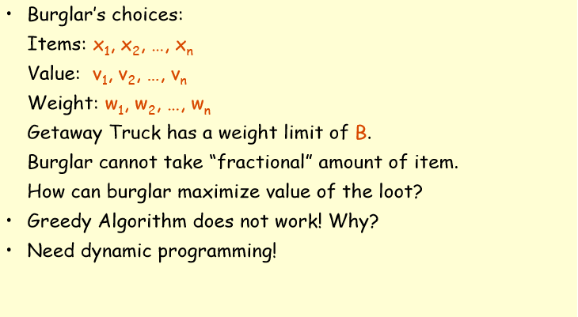
0-1 Knapsack Problem
Notes:
1️⃣ 0–1 Knapsack Problem
🔹 Definition
In 0–1 Knapsack, each item is either taken completely (1) or not taken at all (0).
Items cannot be divided.
🔹 Given
n items
Each item has:
Weight (wi)
Value (vi)
Knapsack capacity = W
Goal:
👉 Maximize total value
👉 Total weight ≤ W
🔹 Important Property
✔ Items are indivisible
✔ Uses Dynamic Programming
✔ Greedy may fail
🔹 Simple Example
Capacity = 50
Item Weight Value
10 60
20 100
3 30 120
If we apply greedy (by ratio):
Ratios:
Item 1 → 6
Item 2 → 5
Item 3 → 4
Greedy picks:
Item 1 (10) → remaining 40
Item 2 (20) → remaining 20
Item 3 cannot fit (needs 30)
Total profit = 160
But better solution is:
Item 2 + Item 3
Weight = 50
Profit = 220 ✅
So greedy fails here.
Hence we use Dynamic Programming.
🟢 2️⃣ Fractional Knapsack Problem
🔹 Definition
In Fractional Knapsack, items can be divided. We can take full item or part of it.
🔹 Important Property
✔ Items are divisible
✔ Uses Greedy
✔ Always gives optimal solution
🔹 Same Example
Capacity = 50
Greedy picks:
Item 1 → 10 weight
Item 2 → 20 weight
Remaining capacity = 20
Take 20/30 of Item 3
Profit:
60 + 100 + 80 = 240 ✅
Here greedy gives optimal solution.

Slide 9
Elements of Dynamic Programming (DP)
Dynamic Programming solves the sub-problems bottom up.
  The problem can’t be solved until we find all solutions of sub-problems.
  The solution comes up when the whole problem appears.
  The solution is obtained when the whole problem disappears.
  DP has to try every possibility before solving the problem.
  It is much more expensive than greedy.

Slide 10
Elements of Dynamic Programming (DP)
DP is used to solve problems with the following characteristics:
Simple subproblems
  We should be able to break the original problem to smaller subproblems that have the same structure
Optimal substructure of the problems
  The optimal solution to the problem contains within optimal solutions to its subproblems.
Overlapping sub-problems
  there exist some places where we solve the same subproblem more than once.

Slide 11
Steps to Designing a
Dynamic Programming Algorithm
Characterize optimal substructure
  Develop a mathematical notation for a given problem
2. Recursively define the value of an optimal solution
3. Compute the value bottom up
4. (if needed) Construct an optimal solution
Notes:
🟢 Simple Example – Fibonacci (Complete Flow)
Step 1: Subproblem → Find F(n-1), F(n-2)
Step 2: Recurrence → F(n)=F(n-1)+F(n-2)
Step 3: Base Case → F(0)=0, F(1)=1
Step 4: Build table from 0 to n
Step 5: Final answer = F(n)

Slide 12
Principles of Optimality
It states that
“In an optimal sequence of decisions or choices each sub sequence must also be optimal”
When it is not possible to apply this principal then we can not solve the problem using DP
Notes:
The Principle of Optimality states that an optimal solution to a problem contains optimal solutions to its subproblems.
🟢 Simple Meaning
If you break a big problem into smaller pieces,
each piece must be solved in the best possible way.
Otherwise, the final solution cannot be best.
🟢 Example 1: Shortest Path
Suppose the shortest path from A → C goes through B.
So path is:
A → B → C
For this to be shortest:
Path A → B must be shortest
Path B → C must be shortest
If A → B is not shortest,
then the total path cannot be shortest ❌
This satisfies Principle of Optimality ✅

Slide 13
Elements of DP
Optimal substructure:
  It uses optimality principle to find optimal solution
Overlapping subproblems:
  Problem is divided into subproblems
  Solutions of subproblems are shared to get the final solution
  Avoids repetition of work to get the solution more efficiently

Slide 14
Application of DP
0/1 Knapsack Problem
Optimal Binary Search Tree
Travelling Salesmen Problem
Multistage Graph
Reliability Design
Matrix Chain Multiplication

Slide 15
0-1 Knapsack problem
Given a knapsack with maximum capacity W, and a set S consisting of n items
Each item i has some weight w_{i} and benefit value b_{i} (all w_{i} , b_{i} and W are integer values)
Problem: How to pack the knapsack to achieve maximum total value of packed items?
The problem is called a “0-1” problem, because each item must be entirely accepted or rejected.
Just another version of this problem is the “Fractional Knapsack Problem”, where we can take fractions of items.

Slide 16
Solving 0-1 Knapsack problem by DP
Use recurrence relation as
  table [I,j] = max{table[ i-1, j ], v_{i} + table[i-1,w_{i}]}
  if j >= w_{i}
  OR
  table [i-1,j] if j < w_{i}
Initially table[i,0] = 0 as well as table[0,j] = 0 when j>=0 and i>=0
Time complexity of this algorithm is O(nW)

Slide 17
Example 1
For the given instance of problem obtain the optimal solution for the Knapsack problem
The capacity of the Knapsack is W = 5
Item | Weight | value
1 | 2 | 3
2 | 3 | 4
3 | 4 | 5
4 | 5 | 6

Slide 18
Example-1
Initially the table [0,i] = 0 and table [i,0] = 0.
  Fill up the table either row or column wise using the recurrence relation formula.
0 1 2 3 4 5
0
1
2
3
4
table [I,j] = max{table[i-1,j],vi + table[i-1, w_{i} ]} if j >= w_{i}
or
table [i-1,j] if j < w_{i}
0 | 0 | 0 | 0 | 0 | 0
0
0
0
0

Slide 19
Example 1
  table [i,j] = max{table[i-1,j],v_{i} + table[i-1,w_{i}]} if j >= w_{i}
  or
  table [i-1,j] if j < w_{i}
Table[1,1] with I,j =1; w_{i} =2 and v_{i} =3
As j < wi
Table[1,1] = table[i-1,j] = table [0,1] = 0
Table[1,1] = 0
update this value in the table
Item | Weight | value
1 | 2 | 3
2 | 3 | 4
3 | 4 | 5
4 | 5 | 6

Slide 20
Example 1
The final table is
How to find knapsack items?
0 1 2 3 4 5
0
1
2
3
4
0 | 0 | 0 | 0 | 0 | 0
0 | 0 | 3 | 3 | 3 | 3
0 | 0 | 3 | 4 | 4 | 7
0 | 0 | 3 | 4 | 5 | 7
0 | 0 | 3 | 4 | 5 | 7

Slide 21
Example 1
To find final knapsack items
Start with i =4 and k =5
table[4,5] = table[3,5] so do not select 4th item
Now i = i-1; i =3, table[3,5] = table [2,5] so do not select 3rd item
Now i= i-1 = 2; table[2,5] != table[1,5] so select 2nd item.
Now i=i-1 = 1 and k= k-wi ; i=1,k=5-3= 2;
As table[1,2] != table[0,2] select 1st item.
Now i=i-1 = 0; k = 2-2 =0; so 1st and 2nd items are selected (1,1,0,0)
0 1 2 3 4 5
0
1
2
3
4
0 | 0 | 0 | 0 | 0 | 0
0 | 0 | 3 | 3 | 3 | 3
0 | 0 | 3 | 4 | 4 | 7
0 | 0 | 3 | 4 | 5 | 7
0 | 0 | 3 | 4 | 5 | 7
7
Starting point

Slide 22
Exercise 1
Using the DP solve the following problem
W=5
Item | Weight | value
1 | 1 | 12
2 | 3 | 10
3 | 2 | 6

